Slide 1
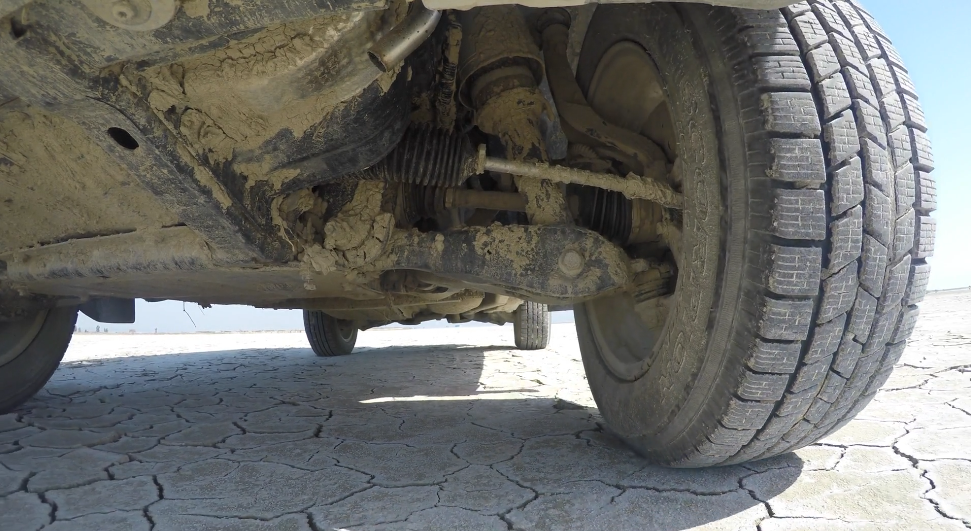
Vibration isolation
Transient response
Tyler Dare

Slide 2
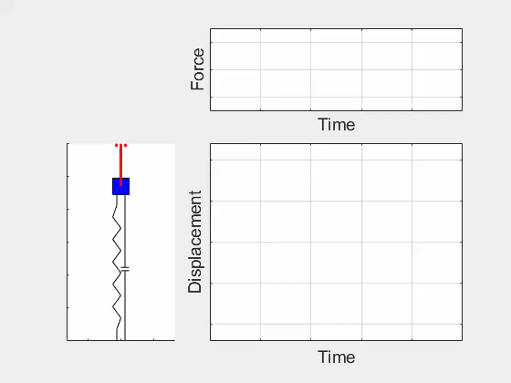
Transient response

Slide 3
Transient response
Sinusoidal forcing (done)
Free response (done)
Arbitrary forced response

Slide 4
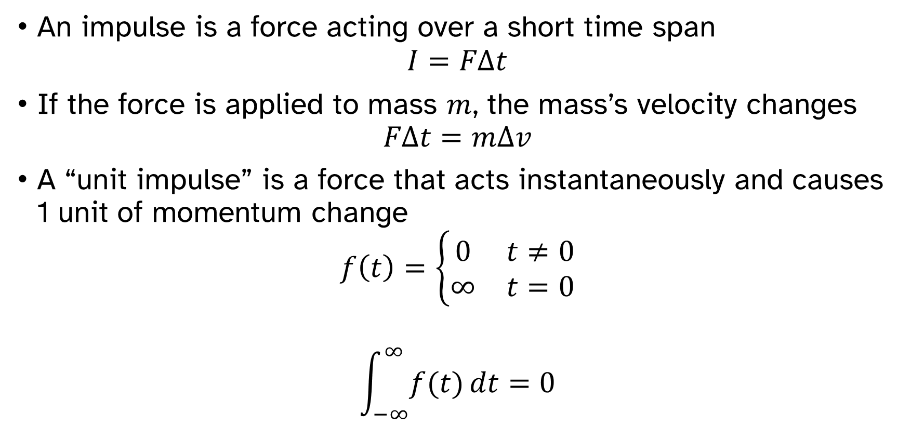
Impulse
An impulse is a force acting over a short time span
$$I=FΔt$$
If the force is applied to mass $m$, the mass’s velocity changes
$$FΔt=mΔv$$
A “unit impulse” is a force that acts instantaneously and causes 1 unit of momentum change
$$f\left(t\right)=\left\{\begin{matrix}0 & t≠0 \\ ∞ & t=0\end{matrix}\right.$$
$$\int_{−∞}^{∞}{f(t)}dt=0$$

Slide 5

Impulse
How does a SDOF system respond to a unit impulse?
$m\ddot{x}+C\dot{x}+k_{s}x=F(t)$
$f\left(t\right)=\left\{\begin{matrix}0 & t≠0 \\ ∞ & t=0\end{matrix}\right.$
$\int_{−∞}^{∞}{f(t)}dt=0$

Slide 6
Impulse
How does a SDOF system respond to a unit impulse?

Slide 7

Impulse response function
$$h(t)=\frac{1}{mω_{d}}e^{−ω_{0}ζt}\sin\left(ω_{d}t\right)$$
How can the impulse response give the solution for arbitrary forces?

Slide 8

Impulse response function
$$h(t)=\frac{1}{mω_{d}}e^{−ω_{0}ζt}\sin\left(ω_{d}t\right)$$

Slide 9
Impulse response function
$$h(t)=\frac{1}{mω_{d}}e^{−ω_{0}ζt}\sin\left(ω_{d}t\right)$$

Slide 10
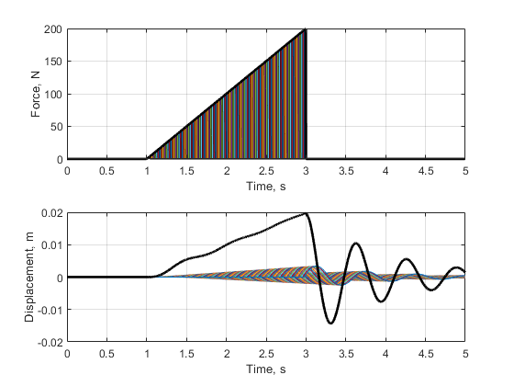
Impulse response function
$$h(t)=\frac{1}{mω_{d}}e^{−ω_{0}ζt}\sin\left(ω_{d}t\right)$$

Slide 11
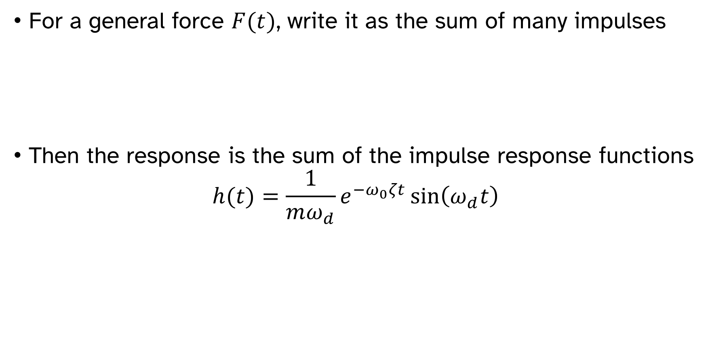
Impulse response function
For a general force $F(t)$, write it as the sum of many impulses
Then the response is the sum of the impulse response functions
$$h(t)=\frac{1}{mω_{d}}e^{−ω_{0}ζt}\sin\left(ω_{d}t\right)$$

Slide 12

Duhamel’s integral
For arbitrary force $F\left(t\right)$, the response $x(t)$ is
$$x\left(t\right)=\int_{0}^{t}{F\left(τ\right)h\left(t−τ\right)dτ}=F(t)∗h(t)$$
$$x\left(t\right)=\frac{1}{mω_{d}}\int_{0}^{t}{F\left(τ\right)e^{−ω_{0}ζ\left(t−τ\right)}\sin\left[ω_{d}\left(t−τ\right)\right]dτ}$$

Slide 13
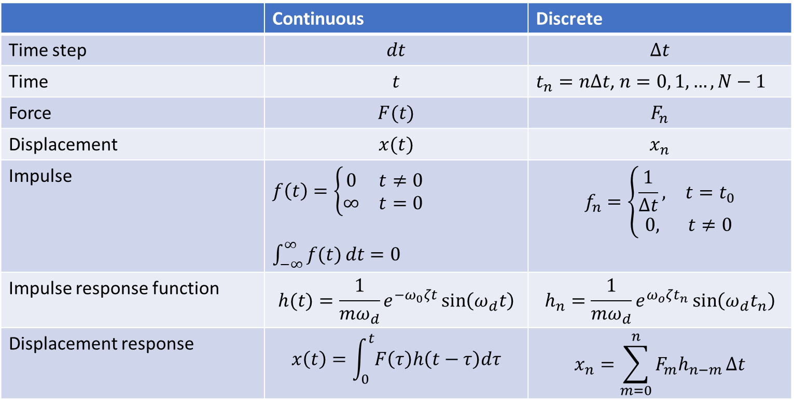
Duhamel’s integral
 | Continuous | Discrete
Time step | $$dt$$ | $$Δt$$
Time | $$t$$ | $t_{n}=nΔt$, $n=0, 1, …,N−1$
Force | $$F(t)$$ | $$F_{n}$$
Displacement | $$x(t)$$ | $$x_{n}$$
Impulse | $f\left(t\right)=\left\{\begin{matrix}0 & t≠0 \\ ∞ & t=0\end{matrix}\right.$ $\int_{−∞}^{∞}{f(t)}dt=0$ | $$f_{n}=\left\{\begin{matrix}\frac{1}{Δt}, & t=t_{0} \\ 0, & t≠0\end{matrix}\right.$$
Impulse response function | $$h(t)=\frac{1}{mω_{d}}e^{−ω_{0}ζt}\sin\left(ω_{d}t\right)$$ | $$h_{n}=\frac{1}{mω_{d}}e^{ω_{o}ζt_{n}}\sin\left(ω_{d}t_{n}\right)$$
Displacement response | $$x\left(t\right)=\int_{0}^{t}{F\left(τ\right)h\left(t−τ\right)dτ}$$ | $$x_{n}=\sum_{m=0}^{n}{F_{m}h_{n−m}}Δt$$

Slide 14
Impulse response function
$$h(t)=\frac{1}{mω_{d}}e^{−ω_{0}ζt}\sin\left(ω_{d}t\right)$$

Slide 15
Duhamel’s integral in MATLAB
MATLAB’s conv function is very useful, but must be used correctly.
x will not be the same length as F. You will need to generate a new time vector.
F is assumed to be zero where it is not defined.
x = conv(F,h)*dt;
t_conv = (0:2*N-2)*dt;

Slide 16
Duhamel’s integral

Slide 17
Duhamel’s integral

Slide 18
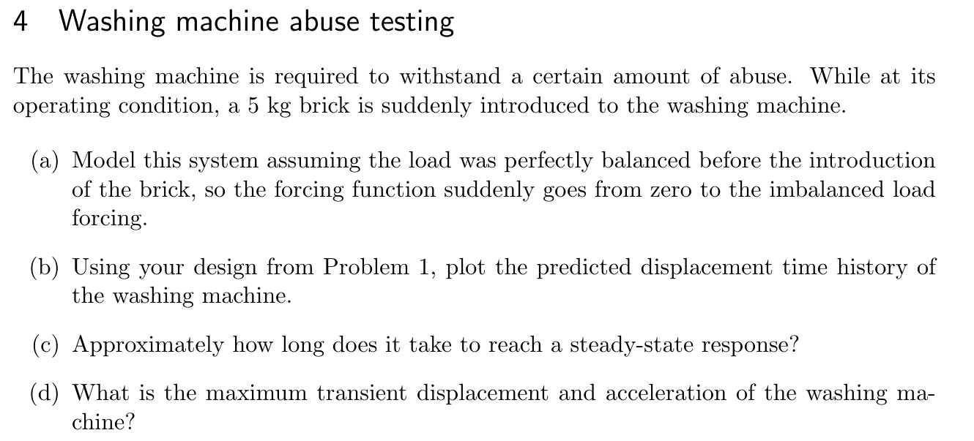

Slide 19
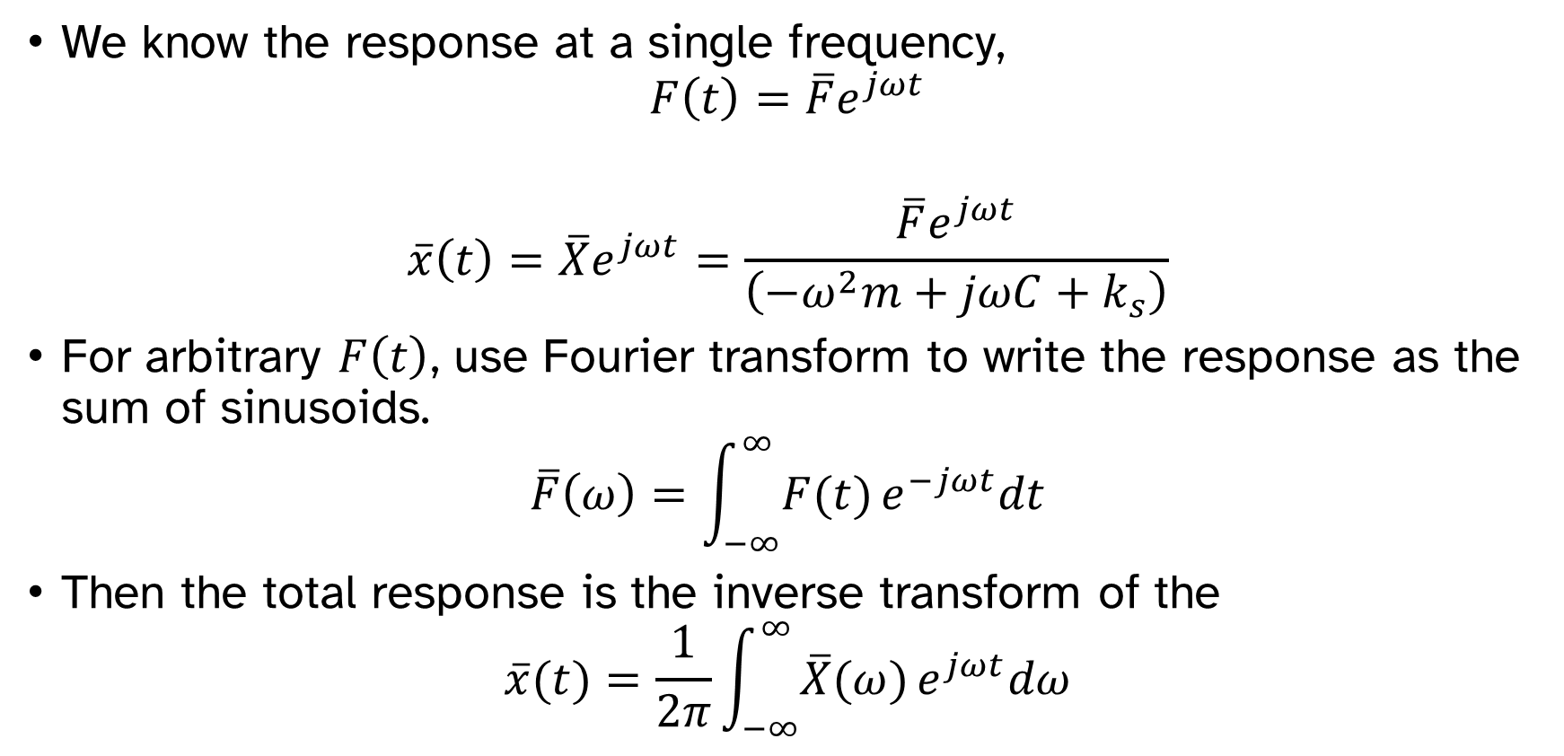
Arbitrary forced response via Fourier transforms
We know the response at a single frequency,
$$F\left(t\right)=\overline{F}e^{jωt}$$
$$\overline{x}\left(t\right)=\overline{X}e^{jωt}=\frac{\overline{F}e^{jωt}}{\left(−ω^{2}m+jωC+k_{s}\right)}$$
For arbitrary $F\left(t\right)$, use Fourier transform to write the response as the sum of sinusoids.
$$\overline{F}\left(ω\right)=\int_{−∞}^{∞}{F(t)}e^{−jωt}dt$$
Then the total response is the inverse transform of the
$$\overline{x}(t)=\frac{1}{2π}\int_{−∞}^{∞}{\overline{X}(ω)}e^{jωt}dω$$

Slide 20


Arbitrary forced response
$$F(t)$$
Write as sum of impulses
Write as sum of sinusoids
Compute response to each impulse
Compute response to each sinusoid
Add responses together
Add responses together
$$x(t)$$

Slide 21
Shock
Response to a transient event, usually large forces over a short time.
Types of shock events:
Impact
Drop
Explosion
Earthquake
Common questions:
Will it survive?
How much damage is expected?

Slide 22
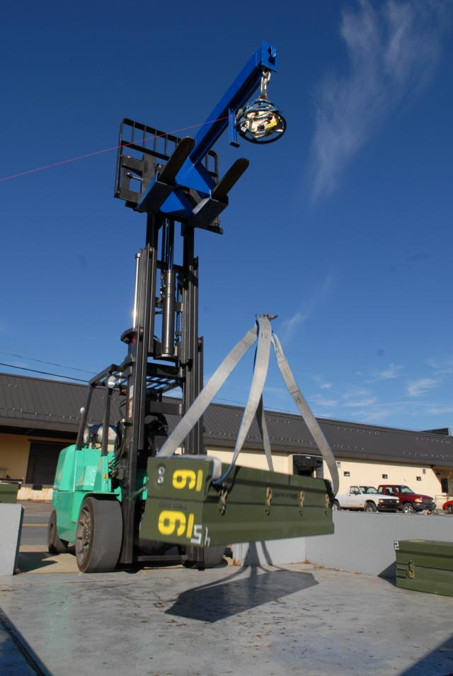
Shock testing
Create the shock event and see what happens.
Explosive shock testing
What if we cannot test all possible events?

Slide 23
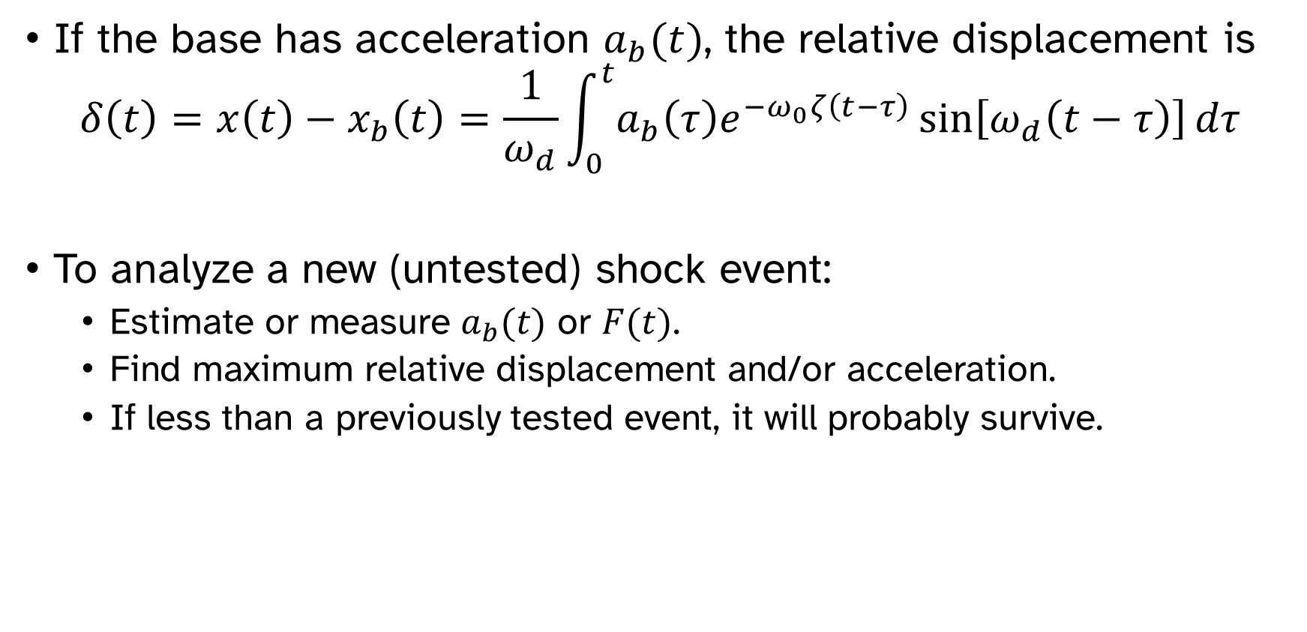
Shock response spectrum
If the base has acceleration $a_{b}(t)$, the relative displacement is
$$δ\left(t\right)=x\left(t\right)−x_{b}\left(t\right)=\frac{1}{ω_{d}}\int_{0}^{t}{a_{b}\left(τ\right)e^{−ω_{0}ζ\left(t−τ\right)}\sin\left[ω_{d}\left(t−τ\right)\right]dτ}$$
To analyze a new (untested) shock event:
Estimate or measure $a_{b}(t)$ or $F(t)$.
Find maximum relative displacement and/or acceleration.
If less than a previously tested event, it will probably survive.

Slide 24

Shock response spectrum
$$δ\left(t\right)=\frac{1}{ω_{d}}\int_{0}^{t}{a_{b}\left(τ\right)e^{−ω_{0}ζ\left(t−τ\right)}\sin\left[ω_{d}\left(t−τ\right)\right]dτ}$$

Slide 25
Shock response spectrum
$$δ\left(t\right)=\frac{1}{ω_{d}}\int_{0}^{t}{a_{b}\left(τ\right)e^{−ω_{0}ζ\left(t−τ\right)}\sin\left[ω_{d}\left(t−τ\right)\right]dτ}$$

Slide 26
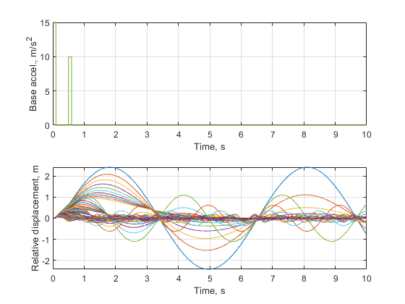
Shock response spectrum
If you have multiple systems or a system with several different modes, you can pre-calculate the response for many different damping ratios and natural frequencies.

Slide 27
Shock response spectrum
Calculate the maximum response for each simulation to produce the “shock response spectrum” for that loading condition.

Slide 28
Shock response spectrum
Calculate the maximum response for each simulation to produce the “shock response spectrum” for that loading condition.

Slide 29
Shock response spectrum
Example: Two different mounts are candidates for a machine. For both mounts, the machine survives shock testing under load condition A. Which mount will most likely also survive load condition B?
Single-stage mount
A
Natural freq. | Damping ratio
13 | 0.02
Two-stage mount
B
Natural freq. | Damping ratio
12 | 0.1
14 | 0.1

Slide 30
Shock response spectrum
Single-stage mount
Natural freq. | Damping ratio
13 | 0.02
Two-stage mount
Natural freq. | Damping ratio
12 | 0.1
14 | 0.1

